Slide 1
Gaming – Alpha beta pruning
Santosh GSK
Industry Expert- AI

Slide 2
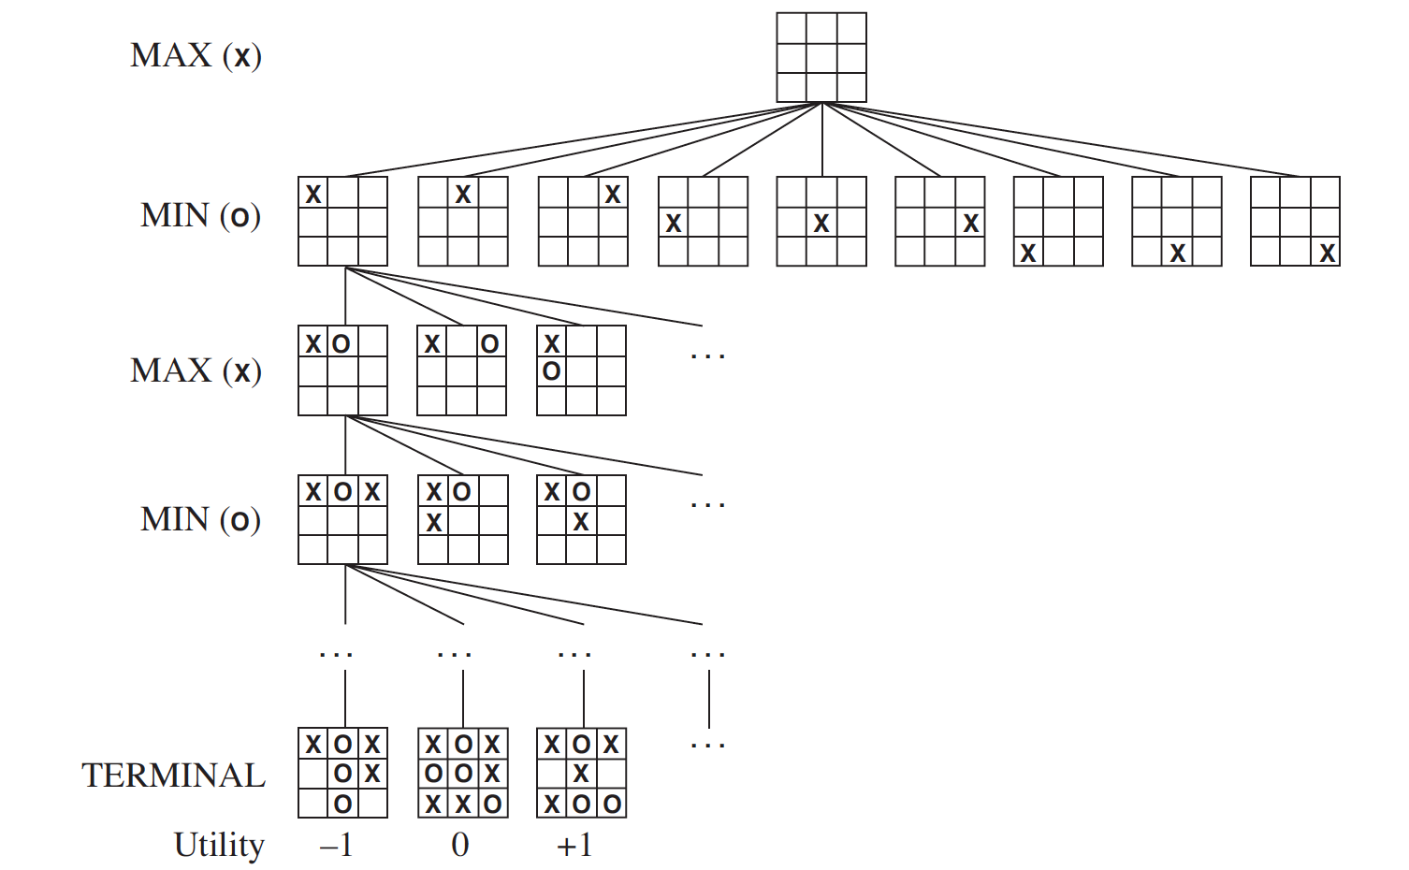
Game Tree

Slide 3
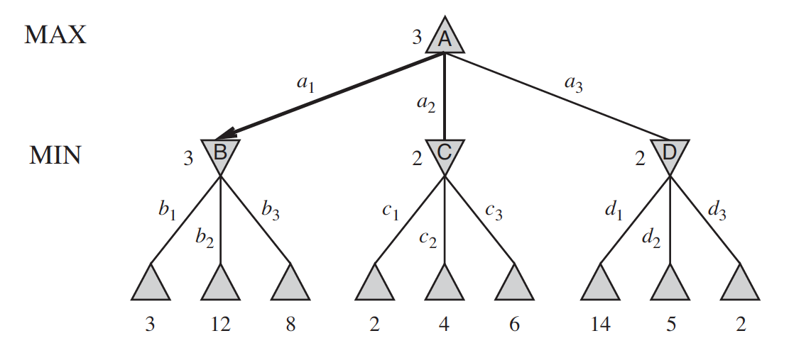
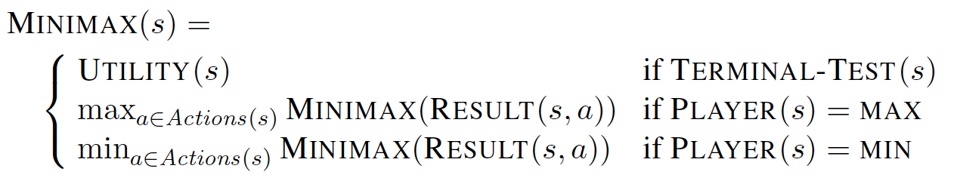
Optimal Strategy: Minimax

Slide 4
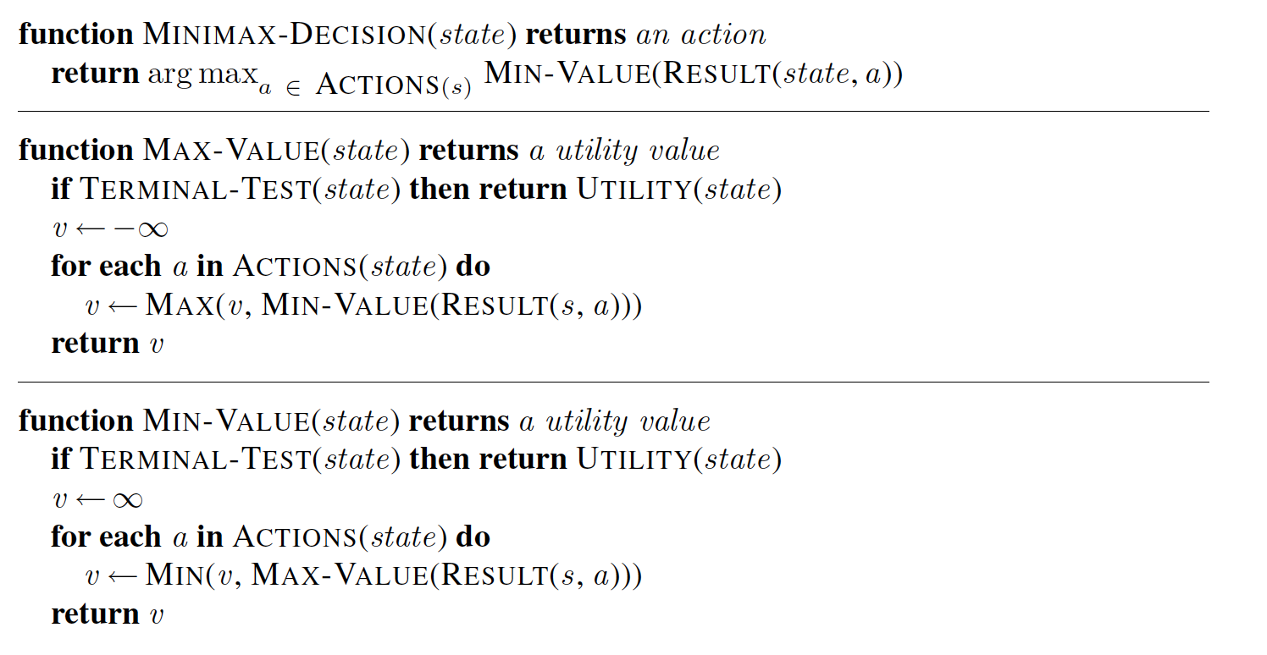
Minimax Algorithm

Slide 5
Minimax Algorithm Limitations
Number of states to examine – exponential in the depth of tree
Cannot eliminate the exponent part
Chess = 10⁴⁰
Go = 10¹⁷⁰
Possible protons in the universe = 10⁹⁰

Slide 6
Minimax Algorithm Limitations
Possible improvement: Compute the minimax decision for a node without looking at every successor node.
Can possible cut down the time in half
It is called Alpha – beta Running

Slide 7
Alpha-Beta Pruning
Pruning – step of ignoring a subset of nodes from further computations
When applied to standard minimax tree, it returns the same action as minimax would however pruning away branches that cannot influence the decision

Slide 8
Alpha-Beta Pruning
Example

Slide 9
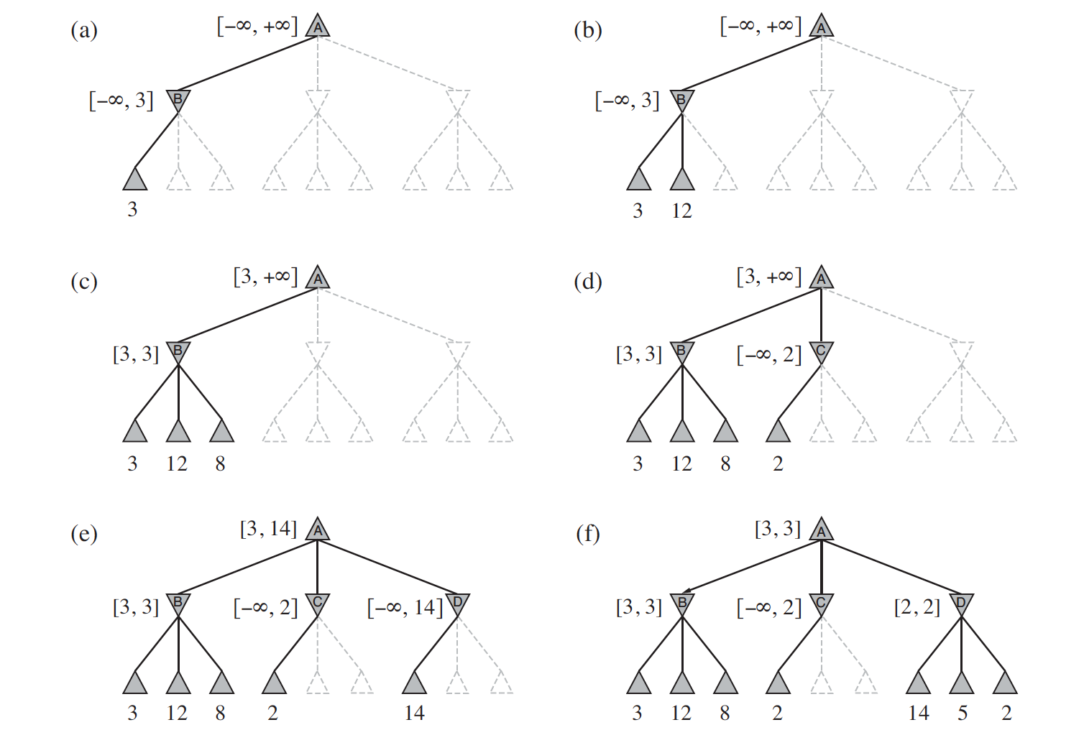
Alpha-Beta Pruning

Slide 10
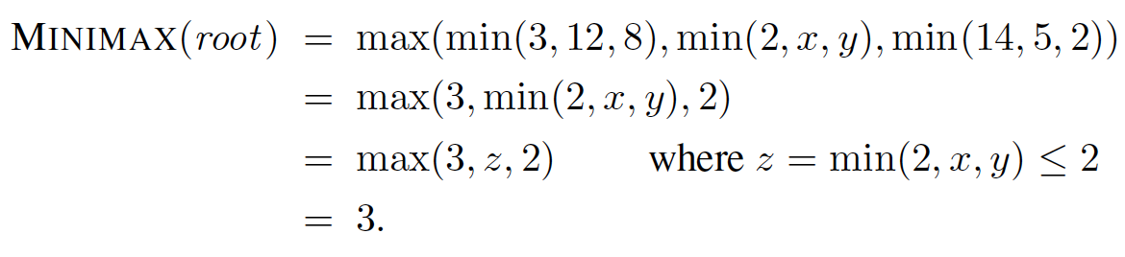
Alpha-Beta Pruning
The value of the root and hence the minimax decision are independent of the pruned values x and y

Slide 11
Alpha-Beta Pruning
Can be applied to trees of any depth and it is often possible to prune entire subtrees rather than just leaves.

Slide 12
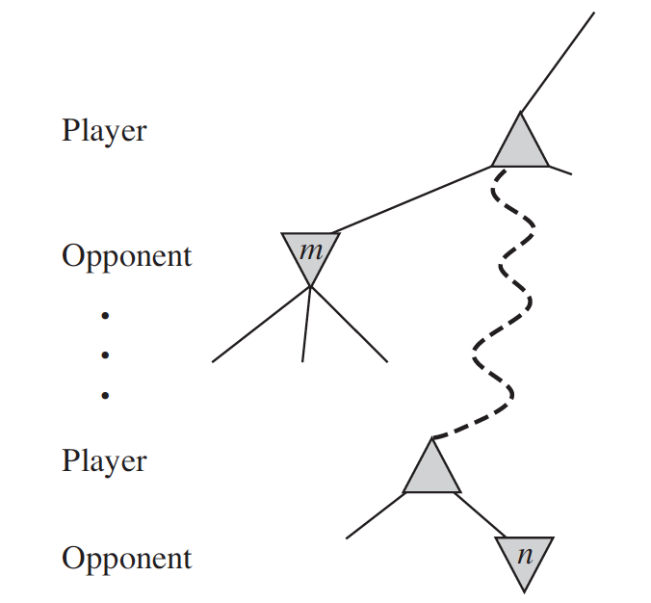
Alpha-Beta Pruning
General Principle: At a node n if a player has better option at the parent of n or further up, then n node will never be reached
Hence the entire subtree from node n can be pruned

Slide 13
Alpha-Beta Pruning
Alpha-beta are the parameters that give the bound on backed up values along the path
Alpha – value of best (highest value) choice we have found so far at any choice point for MAX
Beta – value of best (lowest value) choice we have found so far at any choice point for MIN

Slide 14
Alpha-Beta Pruning
Alpha-beta search updates the values of alpha and beta as it goes along
Prunes the remaining branches at a node whenever the value of current node is worse than alpha and beta for MAX, MIN respectively

Slide 15
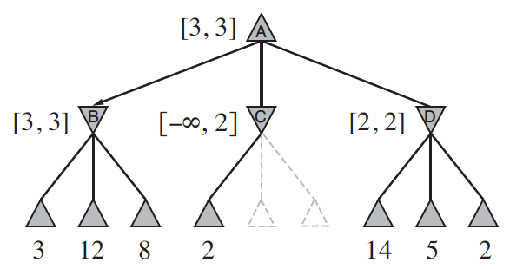
Move Ordering
Effectiveness of alpha-beta is highly dependent on the order in which states are examined

Slide 16
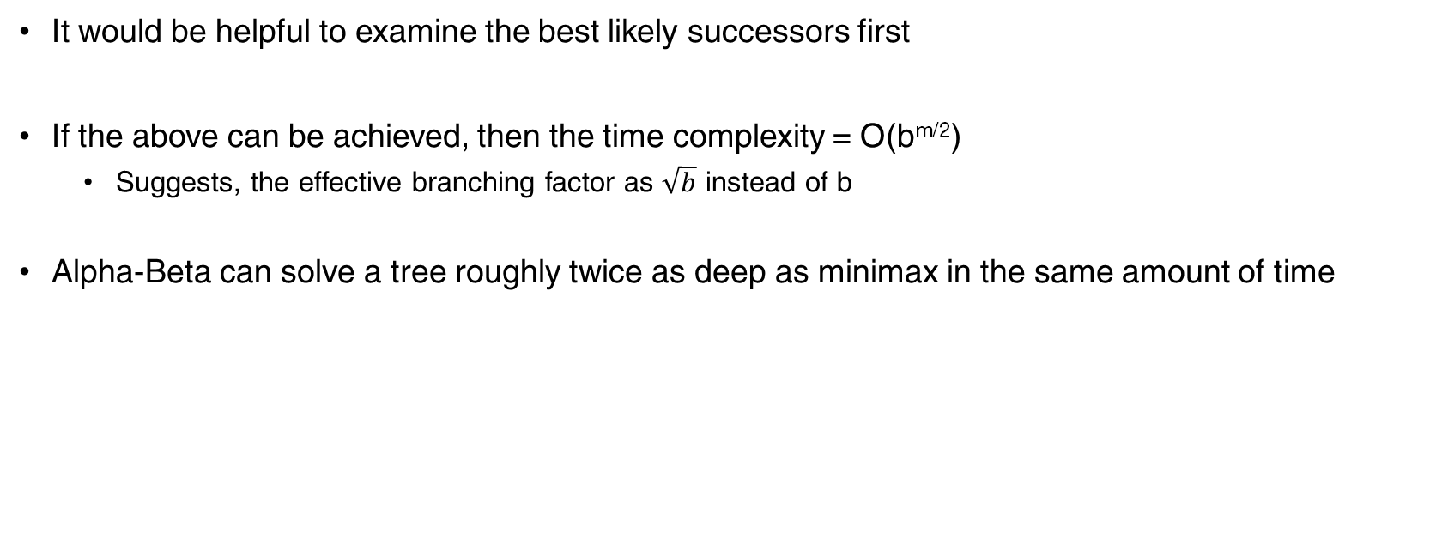
Move Ordering
It would be helpful to examine the best likely successors first
If the above can be achieved, then the time complexity = O(b^{m/2})
Suggests, the effective branching factor as $\sqrt{b}$ instead of b
Alpha-Beta can solve a tree roughly twice as deep as minimax in the same amount of time

Slide 17
Move Ordering
However, if successors are examined in random-order
Time complexity of alpha-beta = O(b^{3m/4})
For games like chess, a simple ordering of suggested steps would bring the complexity to O(b^{m/2})
Adding dynamic move-ordering schemes, like trying moves that performed best in the past can bring us close to theoretical limit
Past can be: previous move, previous exploration of current move

Slide 18
Transpositions
Transposition - Different permutations of move sequence would end up in the same position
In many games, repeated states occur very frequently
Store the evaluation of the resulting position in a hash table the first time it is encountered
Transposition table: Hash tables of previously seen positions

Slide 19
Extending Alpha-Beta
Minimax algorithm need to generate the entire game state-space which is not feasible
Alpha-Beta algorithm would prune sub-trees of the game state-space and hence reducing the state-space search
However, Alpha-Beta would still need to enumerate all action sequence to calculate the Utility value for a portion of the state-space

Slide 20
Extending Alpha-Beta
The Alpha-Beta calculations depends on the depth of the game
Depths are not practical
Many games require a large number of steps before reaching an end game
Moves must be made in a reasonable amount of time

Slide 21
Evaluation Function
Claude Shannon suggested that
Programs can cut off search earlier and apply a heuristic Evaluation Function to states in the search measuring a probable utility value
Modifications to Minimax or Alpha-Beta
Replace the Utility function by a heuristic function EVAL, which estimates the position’s utility and
Replace the Terminal Test by a Cutoff Test that decides when to apply EVAL

Slide 22
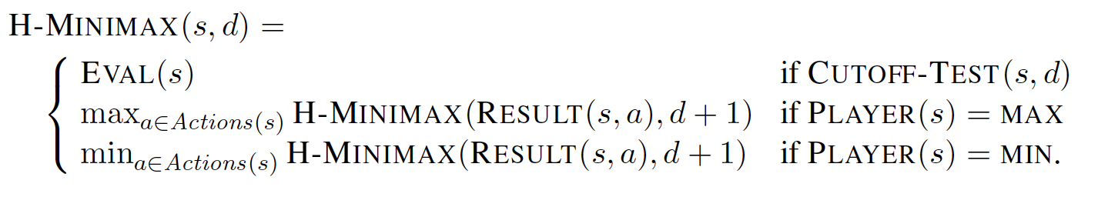
Evaluation Function

Slide 23
Evaluation Function
Evaluation Function – returns the estimate of expected utility of the game from a given position
For centuries, Chess experts had their heuristics in determining the value of a game state
It is obvious that the performance of game-playing program is highly dependent on the evaluation function
How do we design good evaluation function?

Slide 24
Evaluation Function
Certain guidelines to build good evaluation functions
Evaluation function should order the terminal states in the same way as true utility function
Computation must not take too long
For nonterminal nodes, the evaluation function results should be strongly correlated with the actual chances of winning

Slide 25
Evaluation Function
General Approach 1: Calculating various features of a state
E.g., In Chess, we would have features like number of white pawns, black pawns, white queens, black queens and so on.
The features together define various categories of states
The states in each category would have the same feature value
The evaluation function doesn’t look at the exact state, however, calculates the chances of winning by the proportion of times that category has resulted in a win/loss/draw.
E.g., for the category two-pawns vs one-pawn lead to win in 72% of all games, lead to loss in 20% and draw in 8%.
Then the expected evaluation = (0.72 * 1) + (0.2 * 0) + (0.08 * 0.5) = 0.76

Slide 26
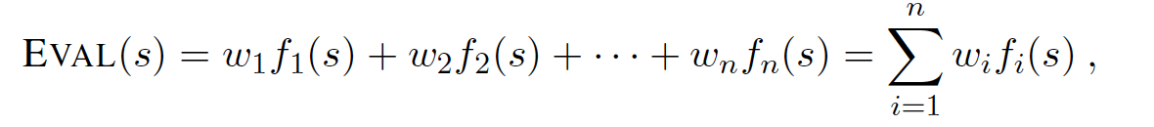
Evaluation Function
General Approach 2: Compute separate numerical contributions from each feature and them combine them to find the total value
E.g., Each pawn is worth 1, a knight/bishop is worth 3, ”good pawn structure” is worth 0.5, “king safety” is worth 1
Simply add them up to get the evaluation score
Or, add them using a weighted linear function

Slide 27
Thank You!
In our next session:
Gaming - Backtracking

